Slide 1
Doing Business with Semantic Technology
Vladimir Alexiev, PhD, PMP
Data and Ontology Management Group

Slide 2
Ontotext Facts
Semantic technology development company
  Established in 2000 as part of Sirma Group
  Spun off in 2008 after venture investment (NEVEQ)
  75 employees
  Offices in Bulgaria (Sofia and Varna), UK (London), USA (New York)
  Global leader in semantic databases and search
Proven Delivery
  More high-profile show cases than competitors
  Highest profile sem web applications
  BBC’s London Olympics 2012 web site
  Semantic search for multinational pharmaceuticals (Astra Zeneca)
Stable and Growing
  Both staff and revenue growing for 12th year in a row
#<number>

Slide 3
Ontotext Verticals, Some Clients
Media & Publishing: BBC, Press Association, EuroMoney, Financial Times, Oxford University Press, NDP, Publicis, IET, Wiley & Sons
Pharmaceuticals: AstraZeneca, UCB
Government and Public sector: US DoD, National Resources Canada, UK National Archives, UK Parliament, EC DG Employment
Cultural Heritage: British Museum, NGA (USA), Europeana, Yale
Telecoms: Korea Telecom, Telecom Italia
#<number>
Notes:
The actual sectors and clients to be presented are:
Media: BBC, PA, EuroMoney
Pharma: AstraZeneca, UCB
Government and Public sector: DoD, NR Canada, TNA, UK Parliament
Cultural Heritage: British Museum, BNL
Telecoms: Korea Telecom, Telecom Italia

Slide 4

























Ontotext Clients
#<number>

Slide 5
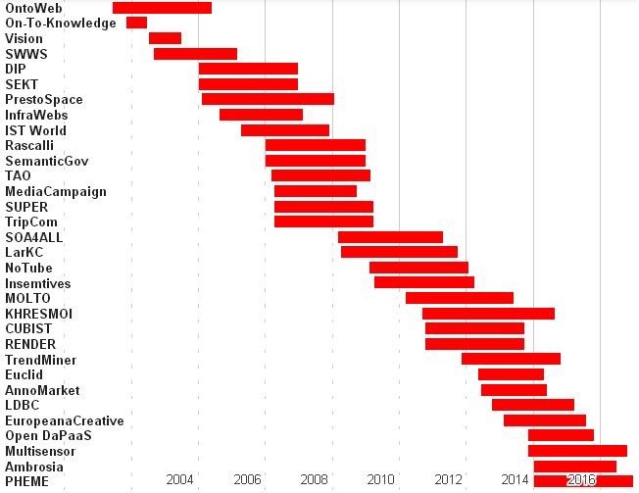
EC Research Projects (FP5-FP7)
Over 30 projects (2002-present).
Nice pipeline (9 currently active)
Varied topics: reasoning, sem web services, eGovernment, life sciences, text analysis, data marketplaces, social network analysis
Bulgaria's biggest participant. FP7: 23% of projects (17 of 72), 36% of funding
#<number>

Slide 6
What do we make?
  Next generation
  database (triplestore)
  Semantic
  search engine
  web server
  for Web 3.0 – the Web of Data
Introduction
#<number>
Notes:
Matt’s slides can come here

Slide 7
Unique Positioning
BigData NoSQL
Web Mining
Data Ware-housing
Text Mining
Ontotext
Triple Stores
Meta-data Management
Database Management
Systems
Content
Management Systems
#<number>

Slide 8
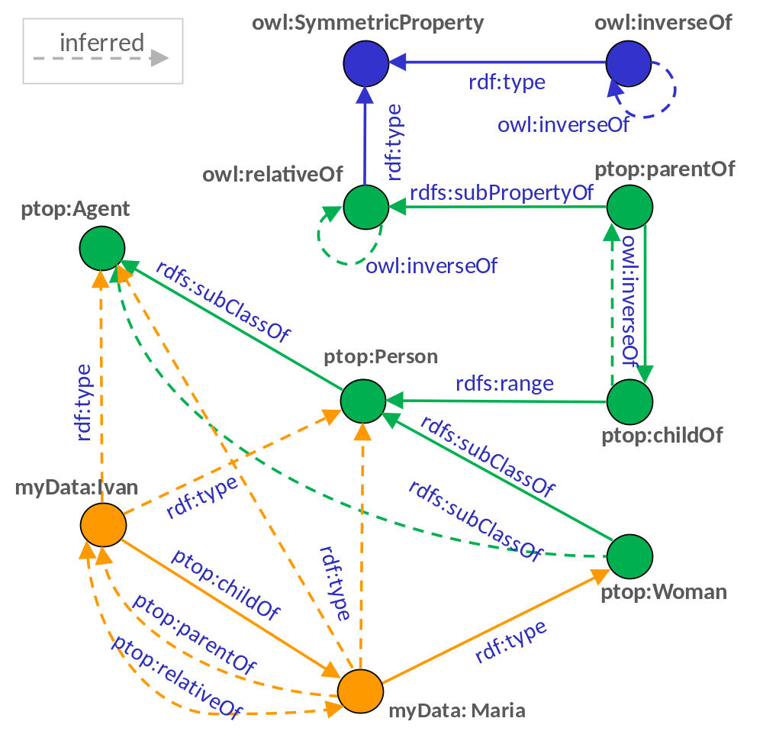
RDF Graph: Data and Schema Together
  Lightweight Inference
  The database will return ‘Ivan’ as result of a query for
  Maria relativeOf ?x
  when the fact asserted was
  Ivan childOf Maria
  Semantic repositories offer the cleanest reasoning approach, delivering best efficiency and lowest cost through the entire data lifecycle
#<number>

Slide 9
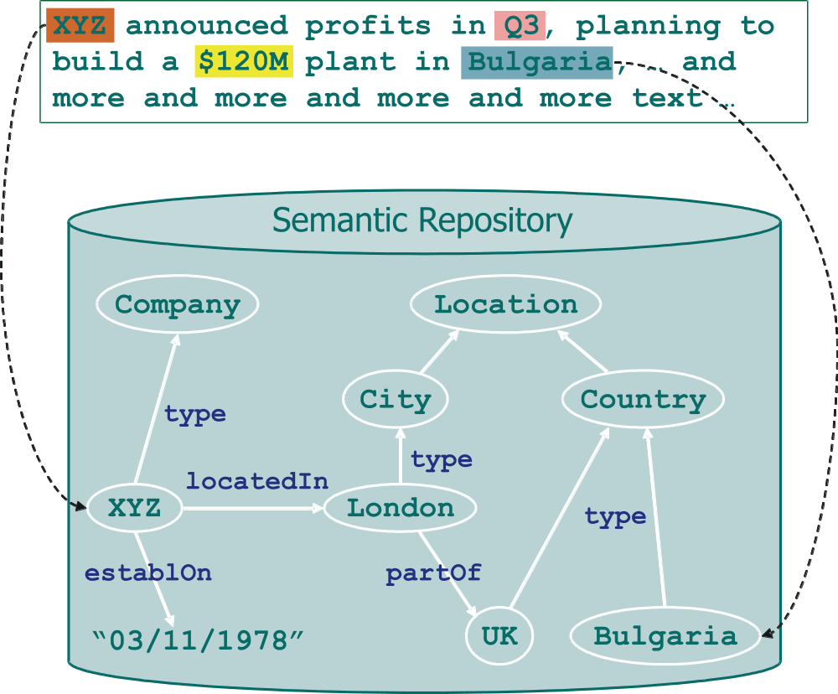
Semantic Annotation: Text to Data
#<number>

Slide 10
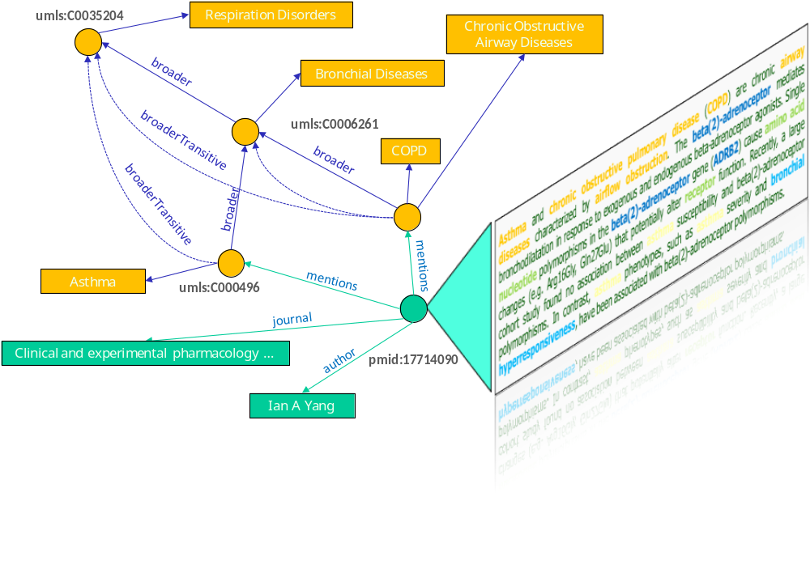
Semantic Annotation: Life Sciences
#<number>
Notes:
Semantic annotation the most powerful linking technique

Slide 11
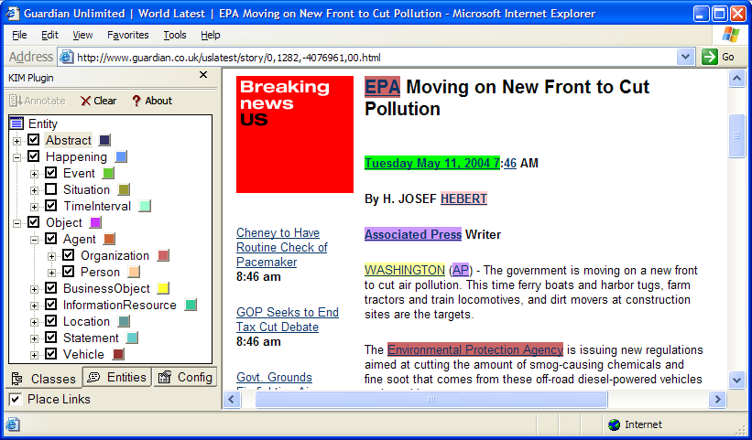
Highlight, Hyperlink, Explore
#<number>

Slide 12
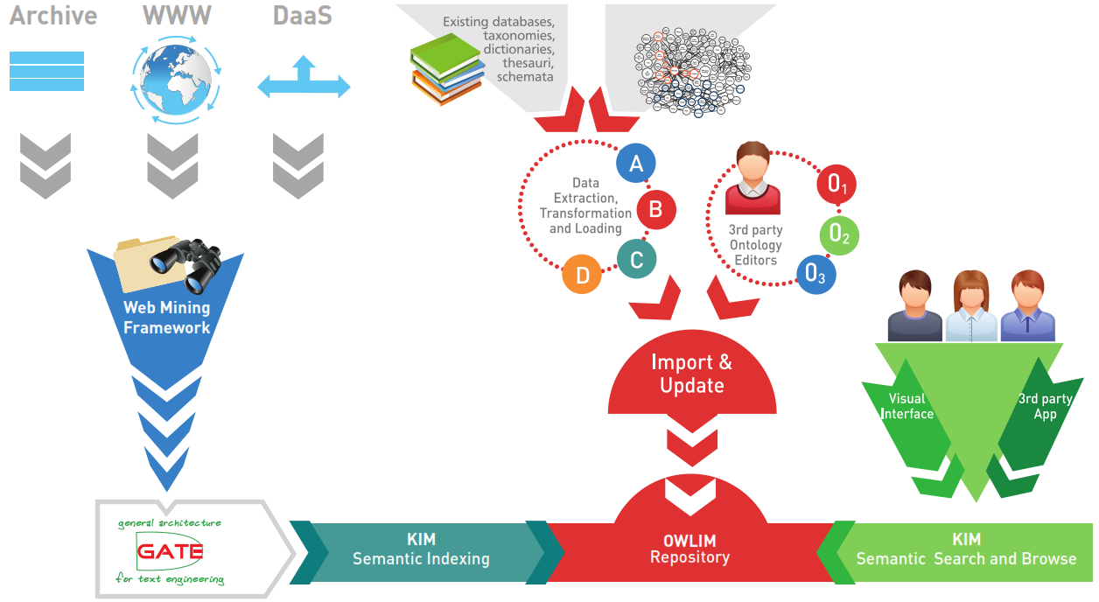
Content and Data Management
#<number>

Slide 13

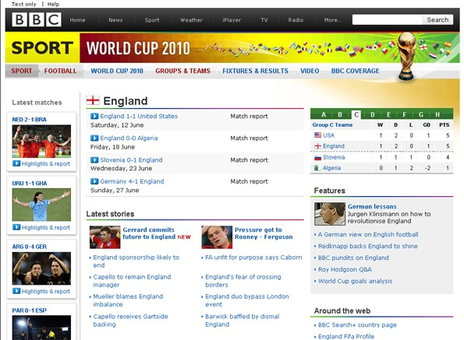
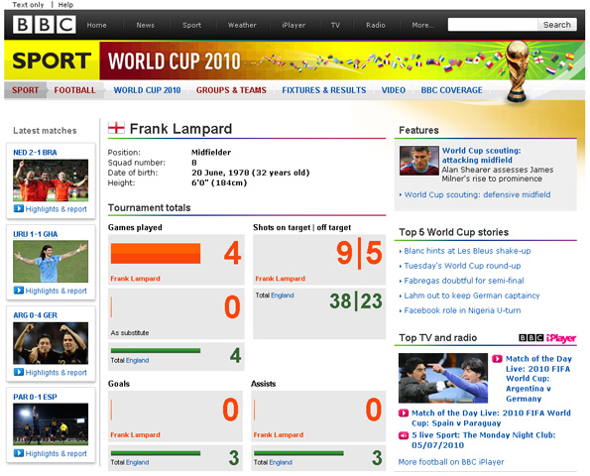
BBC: Dynamic Semantic Publishing
Started with World Cup 2010, grew for Olympics 2012: 200+ Countries, 500 Disciplines, 10000+ Athletes
Each page dynamically assembled from 5 SPARQL queries over OWLIM
OWLIM driven, multiple data centers, multiple caching layers
Annotation driven by Ontotext ‘SPICE’ concept extraction
#<number>
Notes:
We started with BBC helping them develop the first “Dynamic Semantic publishing” side for the Soccer World 2010
The was a big leap forward for the semantic technology, getting it proven in a high-profile project in a way that is hard to fake

Slide 14
A Bit About Me
MS TU Sofia, PhD UAlberta, PMP cert
28y experience in IT: business analysis, data modeling, project management
MS IT PM lecturer at New Bulgarian University
A founder of Sirma Group, largest private IT BG group, Ontotext parent
At Ontotext for 3.5y
Got deep into RDF, RDFS, OWL, thesauri, specific domains & ontologies
Non-semantic: customs, criminal proceedings & legal statistics, eGovernment, social indicators
Semantic: factual data (DBpedia, GeoNames, etc), thesauri, cultural heritage, manuscripts, linguistic linked data, benchmarking

Slide 15
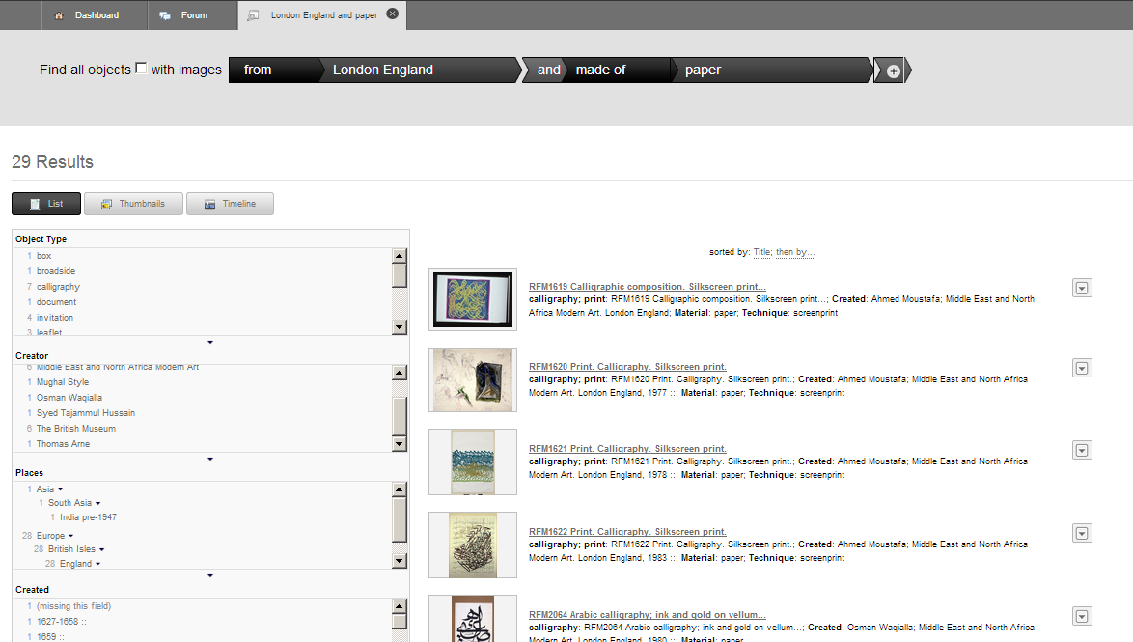
ResearchSpace VRE for British Museum

Slide 16
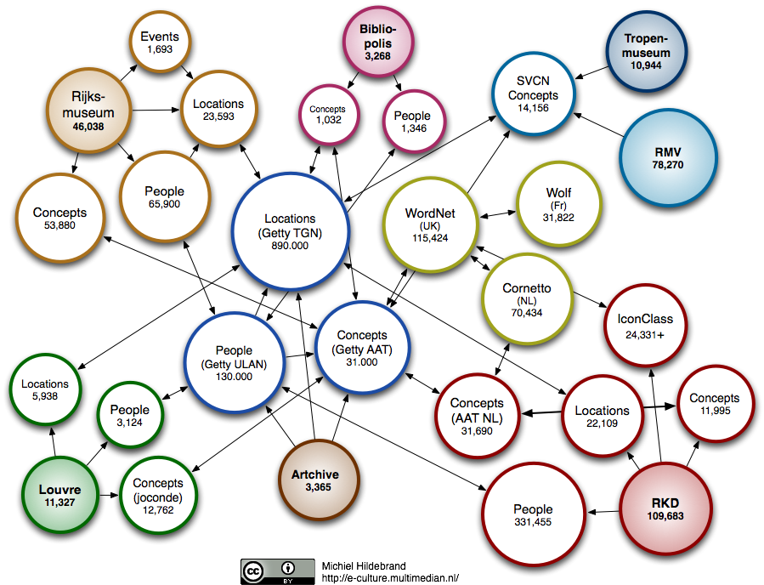
Cultural Heritage LOD Cloud

Slide 17
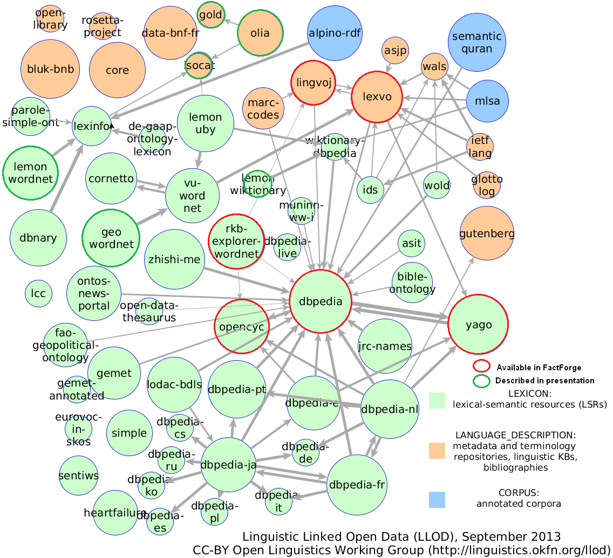
Linguistic Linked Data

Slide 18
Getty Vocabs as LOD
Ontologies used in Getty AAT
Abbrev | Ontology
BIBO | Bibliography Ontology
DC | Dublin Core Elements
DCT | Dublin Core Terms
FOAF | Friend of a Friend ontology
ISO | ISO 25946 Thesaurus ontology
OWL | Web Ontology Language
PROV | Provenance Ontology
RDF | Resource Description Framework
RDFS | RDF Schema
SKOS | Simple Knowledge Organization System
SKOSXL | SKOS Extension for Labels
XSD | XML Schema Datatypes

Slide 19
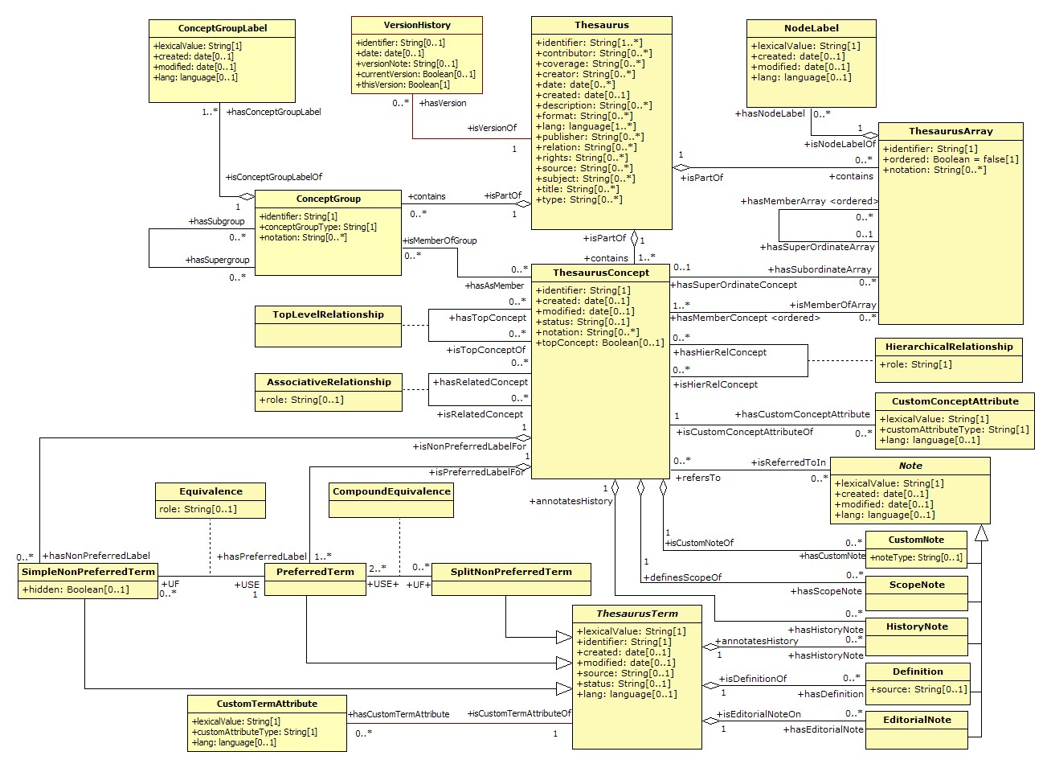
ISO 25964 Thesaurus Standard
First industrial use of ISO 25946 in Getty
Contributed to ISO 25946 ontology

Slide 20
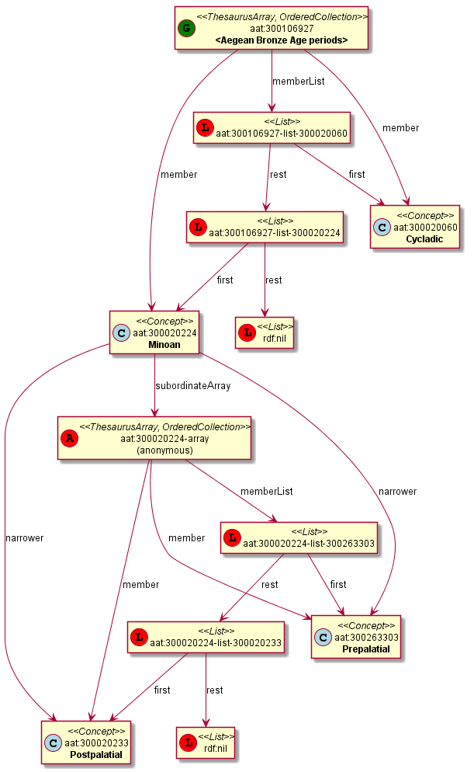
Use of iso:SubordinateArray in Getty
iso:SubordinateArray, skos:memberList, rdf:List…
#<number>

Slide 21
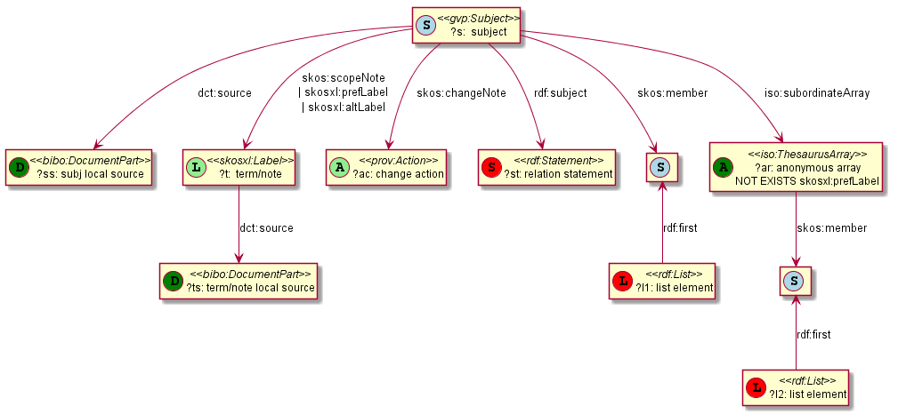
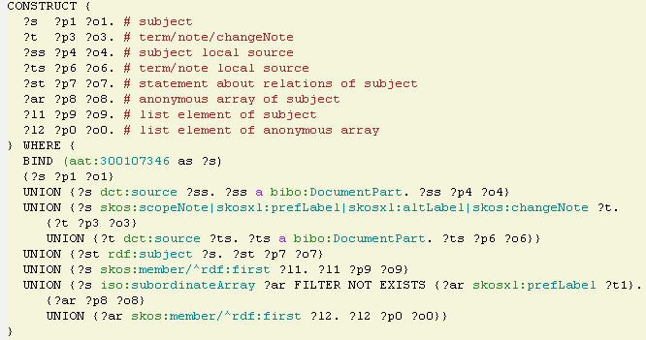
Construct Query to Get All Data
#<number>

Slide 22
Summary
Ontotext has a Unique Technology Portfolio
  Top notch RDF database and text-mining
  One-stop shop for content enrichment and metadata management
  Robust and standard compliant graph database engine
  Marrying Big Data, Deep Data and Semantic Analytics
Wide expertise in varying business domains
  Media
  Publishing and eScience
  Cultural Heritage and Digital Humanities
  Life Sciences and Pharmaceuticals
  Telecoms
My job is very interesting!
  Each month some new domain
  Lots of travel
#<number>

